Slide 1
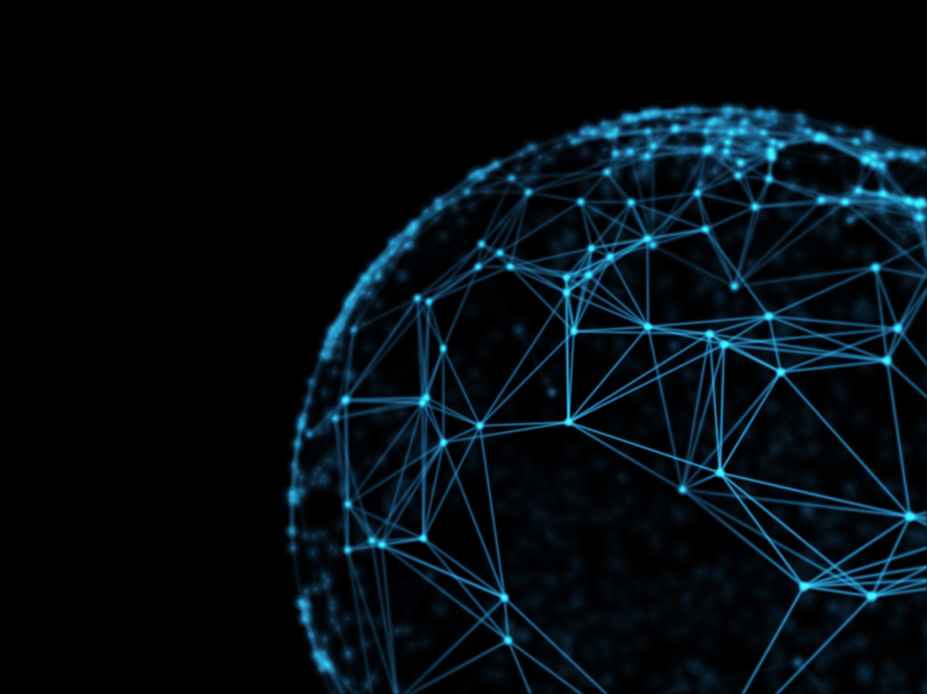
INTERNET OF THING BECOME PART OF OUR LIVES
Team Member:
Ahsan Mansoori (FA19-BSSE-0013)
Muhammad Fahad (FA19-bsse-0013)

Slide 2
INTRODUCTION:
“Things” can refer to a wide variety of devices such as DNA analysis devices for environmental monitoring, electric clamps in coastal waters, Arduino chips in home automation and many other. These devices gather useful data with the help of various existing technologies and share that data between other devices.
Internet of Things is a recent technology that creates a global network of machines and devices that can communicate and exchanging data with each other through the Internet.
The Internet of Things (IoT) is the network of physical objects or "things" embedded with electronics, software, sensors, and network connectivity, which enables these objects to collect and exchange data.
These devices range from ordinary household objects to sophisticated industrial tools. With more than 7 billion connected IoT devices today, experts are expecting this number to grow to 10 billion by 2020 and 22 billion by 2025.

Slide 3
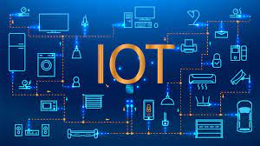
IMPORTANCE OF IoT IN DAILY LIVES

Slide 4
IMPORTANCE OF IoT IN DAILY LIVES
Smarter Natural Disaster Management as ability to predict, the onset condition of forest fires before they out of control or high.
Smarter Urban Management that effectively notice the traffic and govern flow of traffic in city and countries. Park Application is used to guide car for open spot, eliminating wasted of time and speed and many thing.
Smarter Healthcare is defined by the technology that leads to better treatment for patients and devices that improve the quality of life for anyone and everyone.

Slide 5
ADVANTAGES OF IoT

Slide 6
ADVANTAGE OF IoT
Easy Access: Right now, you can easily access the necessary information in real-time, from (almost) whichever location you are at. All it takes is a smart device and internet connection.
Speed: All this data pouring in enables us to complete numerous tasks with envying speed. For example, IoT makes automation easy.
Adapting New Standard: Though IoT is ever-changing, its alterations are minimal compared to the rest of the high-tech world. Without IoT, it would be hard for us to keep track of all the latest updates.
Better Time Management: IoT is an incredible time saving tools, we can search latest news, visit a blog in past time, purchase some item online and many thing.

Slide 7
DISADVANTAGES OF IoT

Slide 8
DISADVANTAGE OF IoT
Data Breach: Data breaches are extremely stressful. Companies also fear them and can lose the trust of their clients for good if the cyber attack came via their website pages.
Dependence: We have become increasingly dependent on the IoT’s everyday usage. Not only in business, but in our private lives.
Complexity: Though IoT seems to be completing tasks with ease, a lot of complex operations are behind it. Consequently, if the software makes a wrong calculation, this will affect the rest of the process.

Slide 9
CONCLUSION
Internet of Things is the concept in which the virtual world of information technology connected to the real world of things. The technologies of Internet of things such as electronic, software, sensor and many more technology to make our life become better and more comfortable.

Slide 10
THANK YOU.

